Slide 1
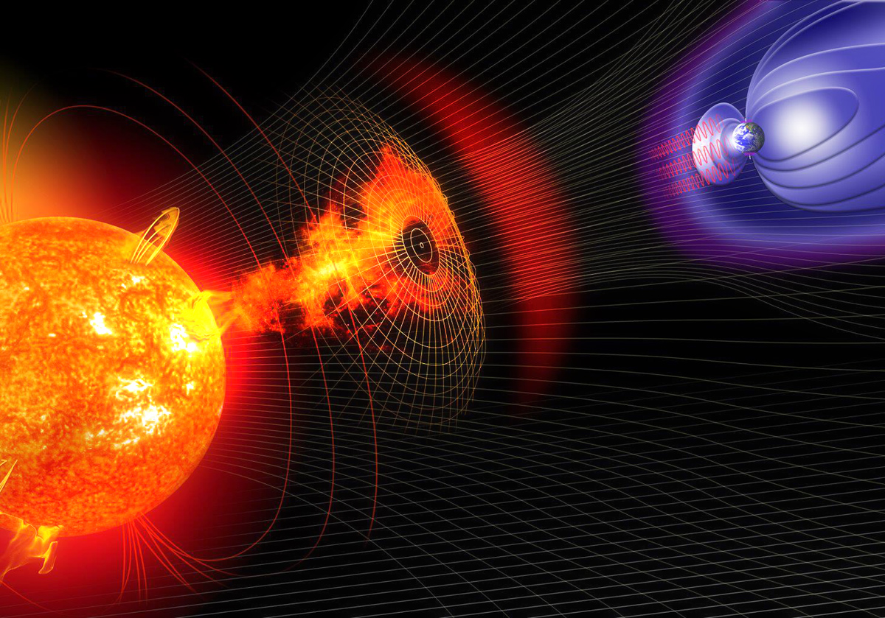
The Solar Wind
Lynn B. Wilson III

Slide 2
Summary
Introduce jargon and basic concepts
Introduce solar wind
Fast vs Slow
Interplanetary magnetic field orientation
Discuss temperature-dependent solar wind properties
Discuss solar wind transients
CIRs/SIRs
ICMEs
SEPs
Briefly mention/introduce fluctuations
Summary

Slide 3
Definitions and Jargon
Fluid: a substance that smoothly and continually deforms under shear stress
Note: The term fluid includes liquid, gas, and plasma states of matter
Neutral Medium: a substance dominated by the interactions of charge-neutral molecules, i.e., binary particle collisions mediate most interactions
Ionized Medium: a substance containing atoms of unbalanced charge
Note: Ionization ranges from weakly (e.g., fire) to fully (e.g., solar corona)
Plasma: an ionized gas that exhibits a collective behavior, due to long-range forces (i.e., electromagnetic) resulting in correlated motions, and has roughly equal positive and negative charged species within a shielding scale length called a Debye sphere

Slide 4
The Solar Wind
The solar wind is not in thermodynamic or even thermal equilibrium
T_{s} ≠ T_{s’} and T⊥ ≠ T//
presence of finite heat fluxes
It is a non-equilibrium kinetic gas
Recent work has even shown evidence of inelastic collisions [Wilson et al., 2019]
The source(s) of the solar wind is still a subject of active study
Early work noticed differences between fast and slow wind (e.g., T_{s} is higher in fast wind)
Fast vs slow has been defined by proton speed but can be defined by other parameters
The sources are thought to strongly depend upon the magnetic field geometry of the solar corona
The winds are known to have different compositions
Observed ions include: H⁺; ⁴He²⁺; ³He²⁺; O^{6+,7+}; C^{4+,5+,6+}; N⁺⁷; Si⁺⁹; Ne⁺⁸; S⁺¹⁰; Fe^{+8 – +17(higher?)}; etc. [e.g., Bame et al., 1968; Bochsler et al., 1985; Gloeckler et al., 1998; Lepri et al., 2013]
Composition: depends on first ionization potential for slow but not fast
L.B. Wilson III et al., “The Statistical Properties of Solar Wind Temperature Parameters Near 1 au,” Astrophys. J. Suppl. 236(8), doi:10.3847/1538-4365/aab71c, 2018.
L.B. Wilson III et al., “Electron Energy Partition across Interplanetary Shocks: I. Methodology and Data Product,” Astrophys. J. Suppl. 243(8), doi:10.3847/1538-4365/ab22bd, 2019.

Slide 5
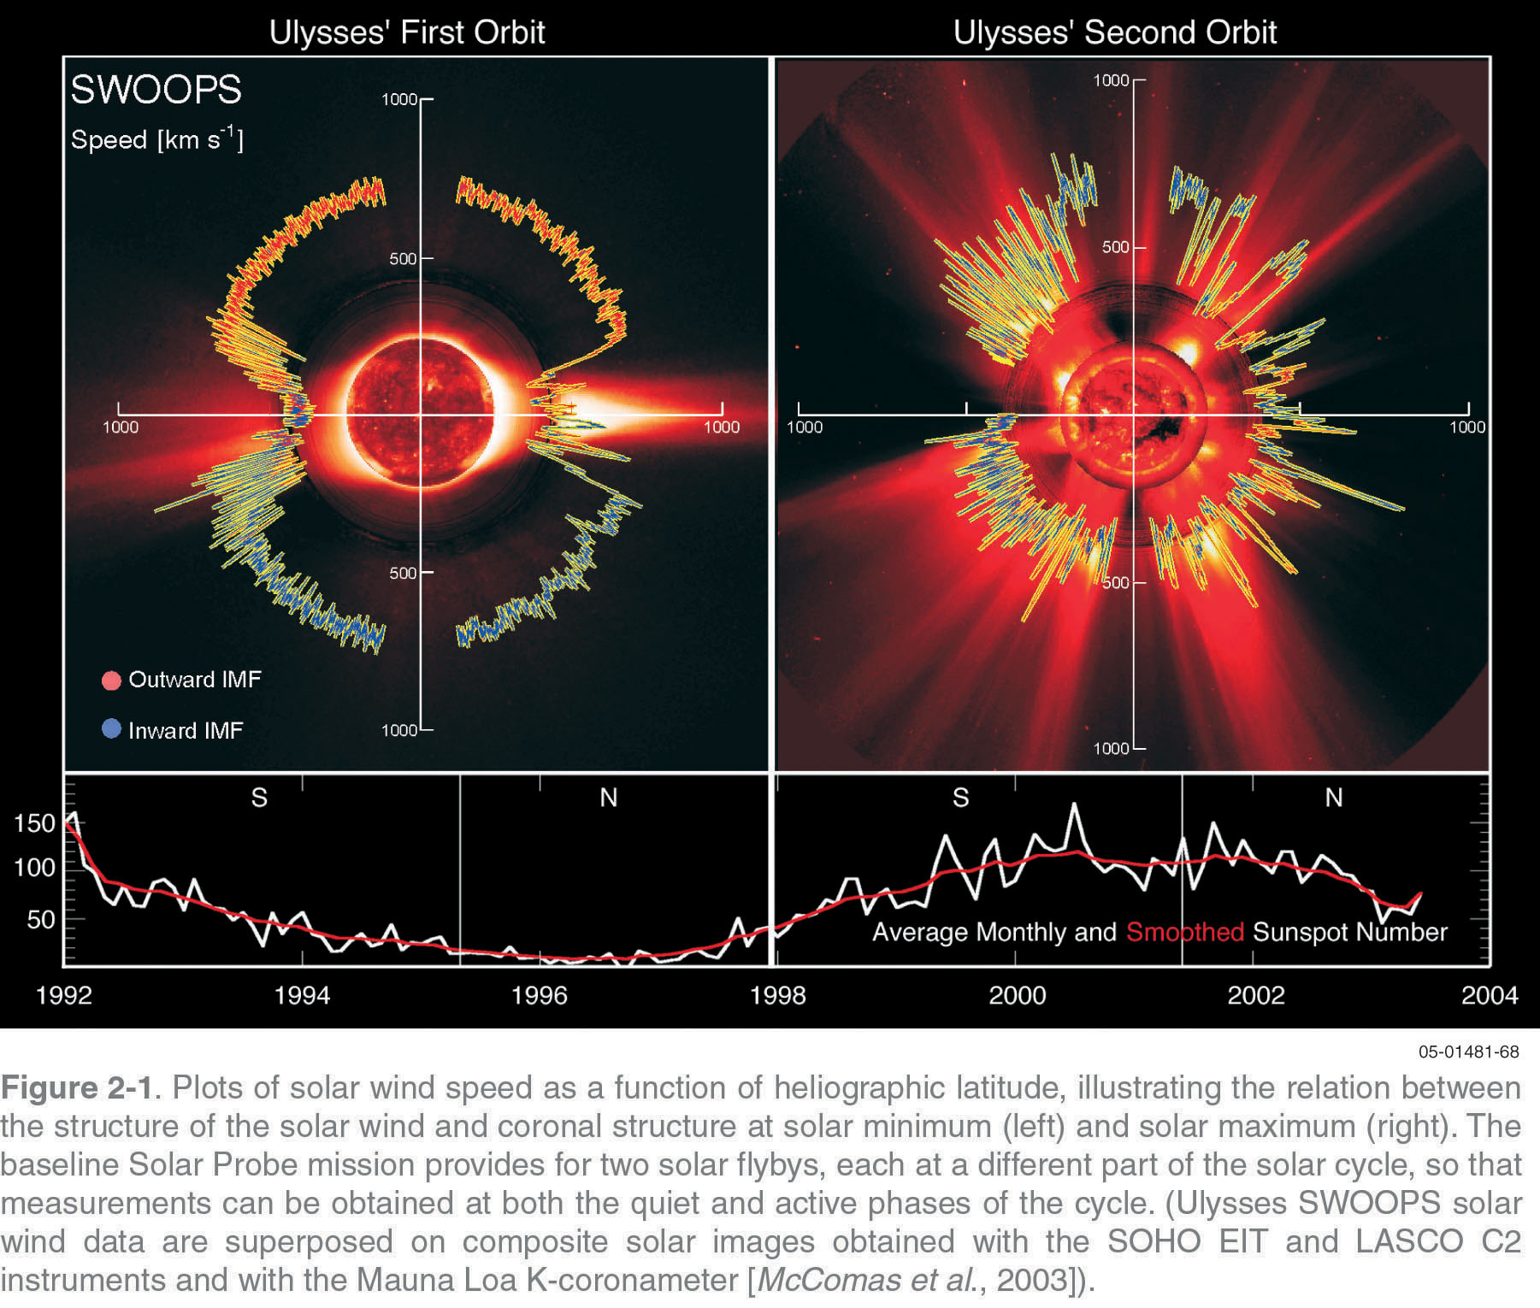
Solar Wind: Source and Types
Notes:
4 x 10^14 BTUs = ~ 8 Billion 50,000 BTU furnaces
1 ton TNT = 4.184 GJ

Slide 6
The Solar Wind
The solar wind is not in thermodynamic or even thermal equilibrium
T_{s} ≠ T_{s’} and T⊥ ≠ T//
presence of finite heat fluxes
It is a non-equilibrium kinetic gas
Recent work has even shown evidence of inelastic collisions [Wilson et al., 2019]
The source(s) of the solar wind is still a subject of active study
Early work noticed differences between fast and slow wind (e.g., T_{s} is higher in fast wind)
Fast vs slow has been defined by proton speed but can be defined by other parameters
The sources are thought to strongly depend upon the magnetic field geometry of the solar corona
The winds are known to have different compositions
Observed ions include: H⁺; ⁴He²⁺; ³He²⁺; O^{6+,7+}; C^{4+,5+,6+}; N⁺⁷; Si⁺⁹; Ne⁺⁸; S⁺¹⁰; Fe^{+8 – +17(higher?)}; etc. [e.g., Bame et al., 1968; Bochsler et al., 1985; Gloeckler et al., 1998; Lepri et al., 2013]
Composition: depends on first ionization potential for slow but not fast
L.B. Wilson III et al., “The Statistical Properties of Solar Wind Temperature Parameters Near 1 au,” Astrophys. J. Suppl. 236(8), doi:10.3847/1538-4365/aab71c, 2018.
L.B. Wilson III et al., “Electron Energy Partition across Interplanetary Shocks: I. Methodology and Data Product,” Astrophys. J. Suppl. 243(8), doi:10.3847/1538-4365/ab22bd, 2019.

Slide 7
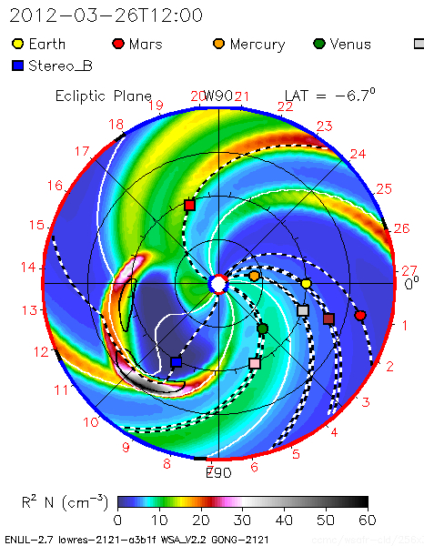
Solar Wind: Source and Types
Parker spiral field
radial field
Notes:
4 x 10^14 BTUs = ~ 8 Billion 50,000 BTU furnaces
1 ton TNT = 4.184 GJ

Slide 8
Solar Wind: Fast vs Slow
The study involved ~10 years of solar wind data observed by the Wind spacecraft [Wilson et al., 2018]
Additional constraints to those already imposed by Wilson et al. [2018]
|(N_{i} – N_{e})/N_{e} x 100%| < 30%
j_{tot}/j_{therm} = |Σ_{s} (q_{s} n_{s} V_{s})/(e n_{e} V_{Te})| < 10%
Fast Solar Wind (FSW) = |V_{p}| > 500 km/s
Slow Solar Wind (SSW) = |V_{p}| ≤ 500 km/s
L.B. Wilson III et al., “The Statistical Properties of Solar Wind Temperature Parameters Near 1 au,” Astrophys. J. Suppl. 236(8), doi:10.3847/1538-4365/aab71c, 2018.
L.B. Wilson III et al., “Electron Energy Partition across Interplanetary Shocks: I. Methodology and Data Product,” Astrophys. J. Suppl. 243(8), doi:10.3847/1538-4365/ab22bd, 2019.

Slide 9
Percentile Ranges All vs Fast vs Slow: X_{25%} - X_{75%}(X_{med})
Parameter | Fast Wind [|V_{p}| > 500 km/s] | Slow Wind [|V_{p}| ≤ 500 km/s] | All wind
N_{e} [cm⁻³] | 3.75 – 6.51(4.52) | 6.37 – 13.8(9.28) | 5.71 – 13.0(8.57)
N_{p} [cm⁻³] | 3.19 – 5.70(4.04) | 5.66 – 12.4(8.28) | 5.05 – 11.7(7.61)
N_{α} [cm⁻³] | 0.14 – 0.26(0.18) | 0.13 – 0.33(0.21) | 0.13 – 0.32(0.21)
N_{p}/N_{i} [%] | 90.3 – 93.3(91.8) | 92.1 – 97.1(94.6) | 91.7 – 96.9(94.1)
N_{α}/N_{i} [%] | 3.49 – 4.92(4.17) | 1.48 – 3.99(2.71) | 1.64 – 4.19(2.97)
L.B. Wilson III et al., “The Statistical Properties of Solar Wind Temperature Parameters Near 1 au,” Astrophys. J. Suppl. 236(8), doi:10.3847/1538-4365/aab71c, 2018.

Slide 10
Percentile Ranges All vs Fast vs Slow: X_{25%} - X_{75%}(X_{med})
Parameter | Fast Wind [|V_{p}| > 500 km/s] | Slow Wind [|V_{p}| ≤ 500 km/s] | All wind
T_{e,tot} [eV] | 10.3 – 13.6(11.8) | 9.26 – 13.0(11.0) | 9.41 – 13.1(11.1)
T_{p,tot} [eV] | 17.8 – 33.2(24.4) | 4.47 – 12.4(7.54) | 4.80 – 15.1(8.45)
T_{α,tot} [eV] | 19.4 – 92.8(55.6) | 5.31 – 31.6(11.5) | 5.43 – 34.0(12.2)
(T⊥/T//)_{e} | 1.11 – 1.35(1.22) | 1.00 – 1.10(1.04) | 1.01 – 1.13(1.05)
(T⊥/T//)_{p} | 0.66 – 1.03(0.82) | 0.59 – 0.95(0.76) | 0.60 – 0.96(0.81)
(T⊥/T//)_{α} | 0.66 – 1.46(0.95) | 0.59 – 1.13(0.84) | 0.60 – 1.14(0.84)
L.B. Wilson III et al., “The Statistical Properties of Solar Wind Temperature Parameters Near 1 au,” Astrophys. J. Suppl. 236(8), doi:10.3847/1538-4365/aab71c, 2018.

Slide 11
Percentile Ranges All vs Fast vs Slow: X_{25%} - X_{75%}(X_{med})
Parameter | Fast Wind [|V_{p}| > 500 km/s] | Slow Wind [|V_{p}| ≤ 500 km/s] | All wind
β_{e,tot} [N/A] | 0.51 – 1.08(0.73) | 0.95 – 2.89(1.62) | 0.83 – 2.64(1.45)
β_{p,tot} [N/A] | 0.92 – 2.12(1.41) | 0.64 – 1.86(1.13) | 0.67 – 1.90(1.16)
β_{α,tot} [N/A] | 0.05 – 0.41(0.19) | 0.02 – 0.18(0.06) | 0.02 – 0.19(0.07)
L.B. Wilson III et al., “The Statistical Properties of Solar Wind Temperature Parameters Near 1 au,” Astrophys. J. Suppl. 236(8), doi:10.3847/1538-4365/aab71c, 2018.

Slide 12
Percentile Ranges All vs Fast vs Slow: X_{25%} - X_{75%}(X_{med})
Parameter | Fast Wind [|V_{p}| > 500 km/s] | Slow Wind [|V_{p}| ≤ 500 km/s] | All wind
(T_{e}/T_{p})_{tot} | 0.36 – 0.65(0.49) | 0.92 – 2.29(1.42) | 0.78 – 2.14(1.28)
(T_{e}/T_{α})_{tot} | 0.12 – 0.45(0.19) | 0.35 – 1.83(0.87) | 0.32 – 1.78(0.82)
(T_{α}/T_{p})_{tot} | 2.28 – 4.75(3.72) | 1.38 – 3.52(1.96) | 1.39 – 3.62(2.01)
L.B. Wilson III et al., “The Statistical Properties of Solar Wind Temperature Parameters Near 1 au,” Astrophys. J. Suppl. 236(8), doi:10.3847/1538-4365/aab71c, 2018.

Slide 13
Particle-particle Coulomb Collisions
L.B. Wilson III et al., “The Statistical Properties of Solar Wind Temperature Parameters Near 1 au,” Astrophys. J. Suppl. 236(8), doi:10.3847/1538-4365/aab71c, 2018.
L.B. Wilson III et al., “Electron Energy Partition across Interplanetary Shocks: I. Methodology and Data Product,” Astrophys. J. Suppl. 243(8), doi:10.3847/1538-4365/ab22bd, 2019.

Slide 14
Percentile Ranges All vs Fast vs Slow: X_{25%} - X_{75%}(X_{med})
Parameter | Fast Wind [|V_{p}| > 500 km/s] | Slow Wind [|V_{p}| ≤ 500 km/s] | All wind
ν_{iaw} [#/day] | 41.8 – 64.4(52.8) | 32.4 – 50.1(42.4) | 33.0 – 52.2(41.6)
ν_{ee} [#/day] | 0.29 – 0.49(0.37) | 0.49 – 1.40(0.79) | 0.43 – 1.30(0.70)
ν_{ep} [#/day] | 0.13 – 0.22(0.16) | 0.21 – 0.63(0.35) | 0.19 – 0.58(0.31)
ν_{eα} [#/day] | 0.022 – 0.040(0.029) | 0.022 – 0.058(0.035) | 0.022 – 0.055(0.034)
ν_{pp} [#/day] | 0.002 – 0.004(0.003) | 0.012 – 0.077(0.030) | 0.008 – 0.067(0.024)
ν_{αα} [#/day] | 0.0002 – 0.003(0.0005) | 0.001 – 0.010(0.004) | 0.001 – 0.010(0.003)
ν_{pα} [#/day] | 0.0002 – 0.0004(0.0003) | 0.0006 – 0.002(0.001) | 0.0005 – 0.002(0.001)
ν_{iaw} assumes δE ~ 0.1 mV/m and waves always present
L.B. Wilson III et al., “The Statistical Properties of Solar Wind Temperature Parameters Near 1 au,” Astrophys. J. Suppl. 236(8), doi:10.3847/1538-4365/aab71c, 2018.

Slide 15
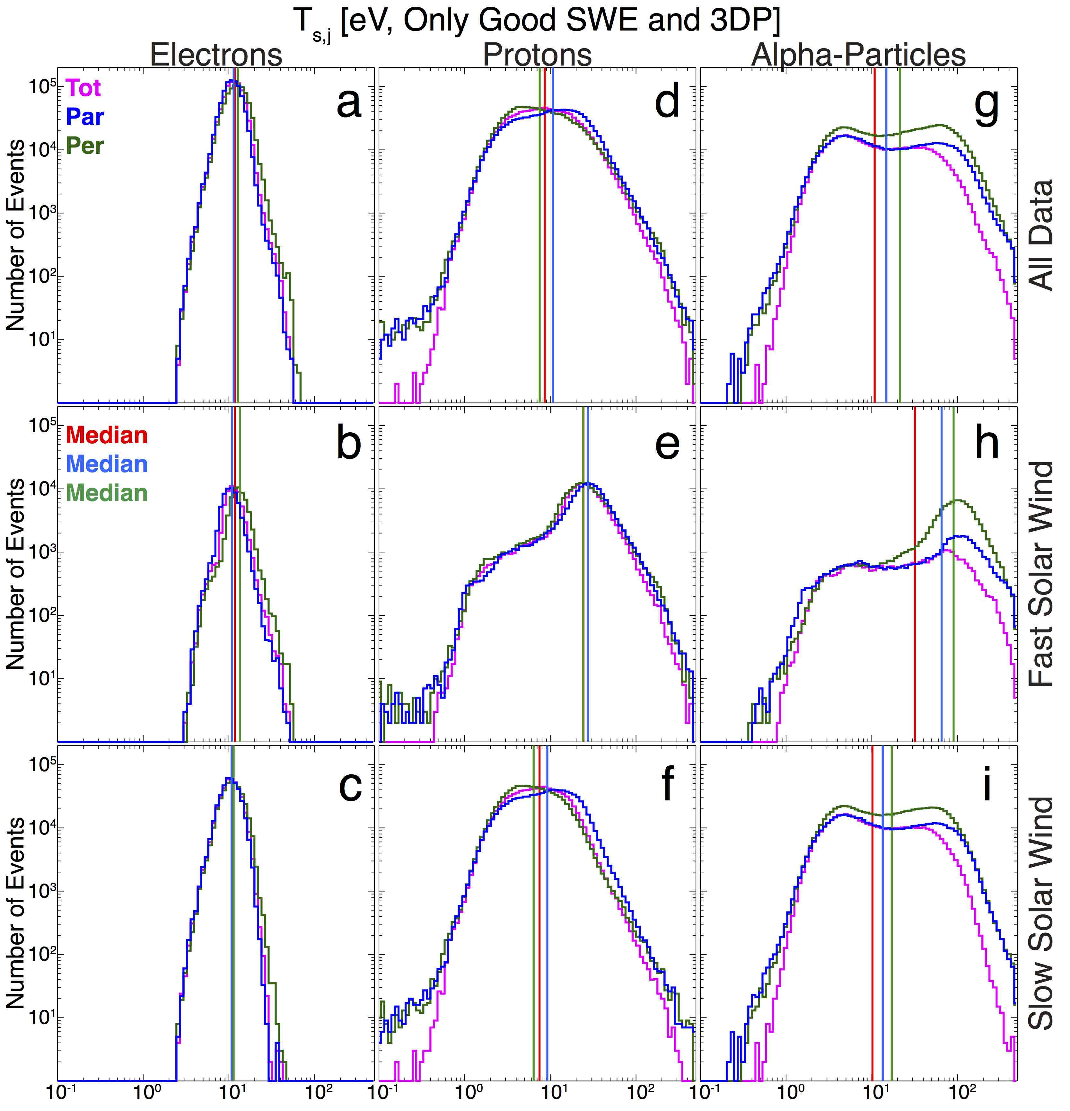

Slide 16
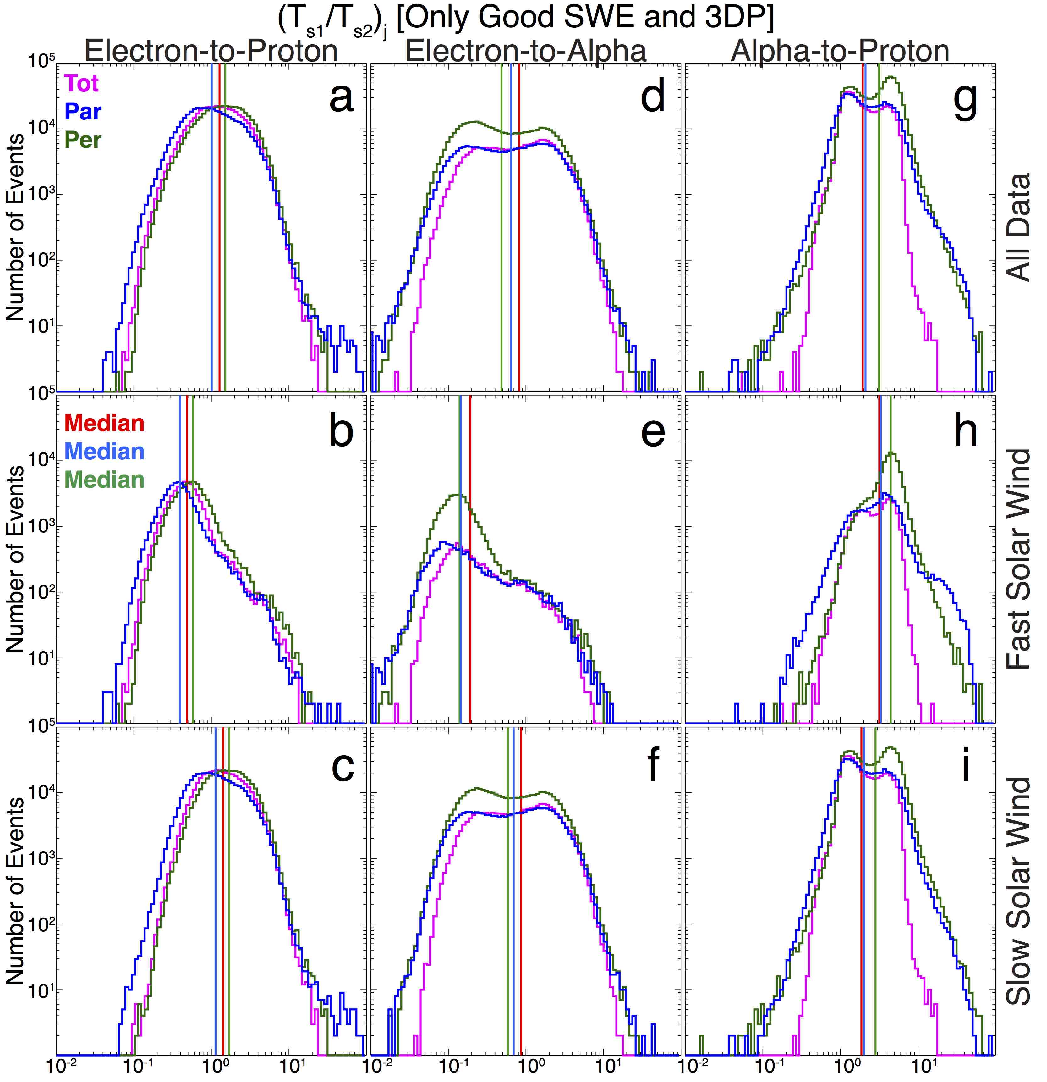

Slide 17
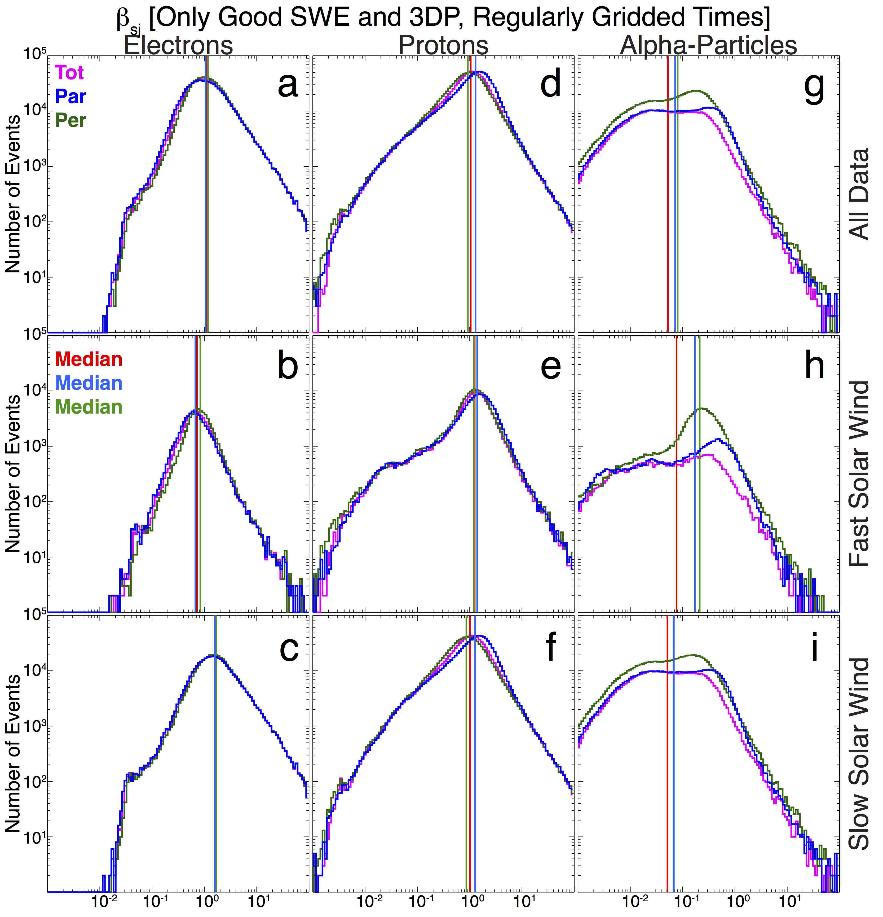

Slide 18
Solar Wind Transients
SIR = stream interaction region [Jian et al., 2006; 2008; 2011]
CIR = co-rotating interaction region
CME = coronal mass ejection
ICME = interplanetary coronal mass ejection
MC = magnetic cloud [Nieves-Chinchilla et al., 2018; Li et al., 2018]
increase in |B_{o}|
rotation in B_{o}
decrease in T_{p}
Flux Rope = similar to magnetic cloud
SEP = solar energetic particles [e.g., Reames, 2017; Richardson et al., 2015]
L.K. Jian et al., “Properties of stream interactions at one AU during 1995 - 2004,” Solar Phys. 239, pp. 337-392, doi:10.1007/s11207-006-0132-3, 2006.
L.K. Jian et al., “Stream Interactions and Interplanetary Coronal Mass Ejections at 0.72 AU,” Solar Phys. 249, pp. 85-101, doi:10.1007/s11207-008-9161-4, 2008.
L.K. Jian et al., “Comparing Solar Minimum 23/24 with Historical Solar Wind Records at 1 AU,” Solar Phys. 274, pp. 321-344, doi:10.1007/s11207-011-9737-2, 2011.
Y. Li et al., “Magnetic Clouds: Solar Cycle Dependence, Sources, and Geomagnetic Impacts,” Solar Phys. 293(135), pp. 19, doi:10.1007/s11207-018-1356-8, 2018.
T. Nieves-Chinchilla et al., “Understanding the Internal Magnetic Field Configurations of ICMEs Using More than 20 Years of Wind Observations,” Solar Phys. 293(25), pp. 31, doi:10.1007/s11207-018-1247-z, 2018.
D.V. Reames “Solar Energetic Particles,” Lecture Notes Phys. 932, pp. 136, doi:10.1007/978-3-319-50871-9, 2017.
I.G. Richardson et al., “The Properties of Solar Energetic Particle Event-Associated Coronal Mass Ejections Reported in Different CME Catalogs,” Solar Phys. 290, pp. 1741-1759, doi:10.1007/s11207-015-0701-4, 2017.
Notes:
4 x 10^14 BTUs = ~ 8 Billion 50,000 BTU furnaces
1 ton TNT = 4.184 GJ

Slide 19
Solar Wind: Source and Types
SIR/CIR
ICME
Notes:
4 x 10^14 BTUs = ~ 8 Billion 50,000 BTU furnaces
1 ton TNT = 4.184 GJ

Slide 20
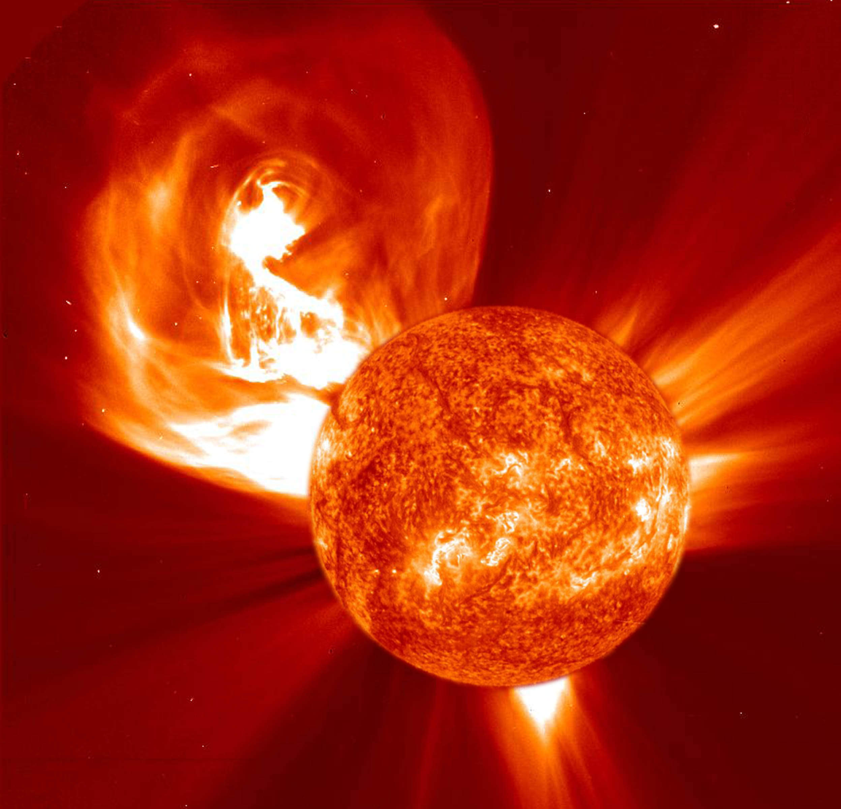
Coronal Mass Ejections (CMEs)
They are the largest explosions
in the solar system (~10²³ to 10²⁶ J
or ~2-200 million 100 Megaton H-bombs
or ~8-4000 x 10¹¹ stone league² jiffy⁻²).
Roughly 2 million times the total
world energy consumption per year
Notes:
4 x 10^14 BTUs = ~ 8 Billion 50,000 BTU furnaces
1 ton TNT = 4.184 GJ

Slide 21
Fast/Slow Streams (SIRs and CIRs)
SIR = stream interaction region [Jian et al., 2006; 2008; 2011]
develops due to a faster flowing region overtaking a slower one
a subset are CIR = co-rotating interaction regions
require lifetime to surpass more than one solar rotation
CIRs/SIRs form shocks
They also drive geomagnetic storms [e.g., Borovsky & Denton, 2006]
J.E. Borovsky & M.H. Denton “Differences between CME-driven and CIR-driven storms,” J. Geophys. Res. 111, pp. A07S08, doi:10.1029/2005JA011447, 2006.
L.K. Jian et al., “Properties of stream interactions at one AU during 1995 - 2004,” Solar Phys. 239, pp. 337-392, doi:10.1007/s11207-006-0132-3, 2006.
L.K. Jian et al., “Stream Interactions and Interplanetary Coronal Mass Ejections at 0.72 AU,” Solar Phys. 249, pp. 85-101, doi:10.1007/s11207-008-9161-4, 2008.
L.K. Jian et al., “Comparing Solar Minimum 23/24 with Historical Solar Wind Records at 1 AU,” Solar Phys. 274, pp. 321-344, doi:10.1007/s11207-011-9737-2, 2011.
Notes:
4 x 10^14 BTUs = ~ 8 Billion 50,000 BTU furnaces
1 ton TNT = 4.184 GJ

Slide 22
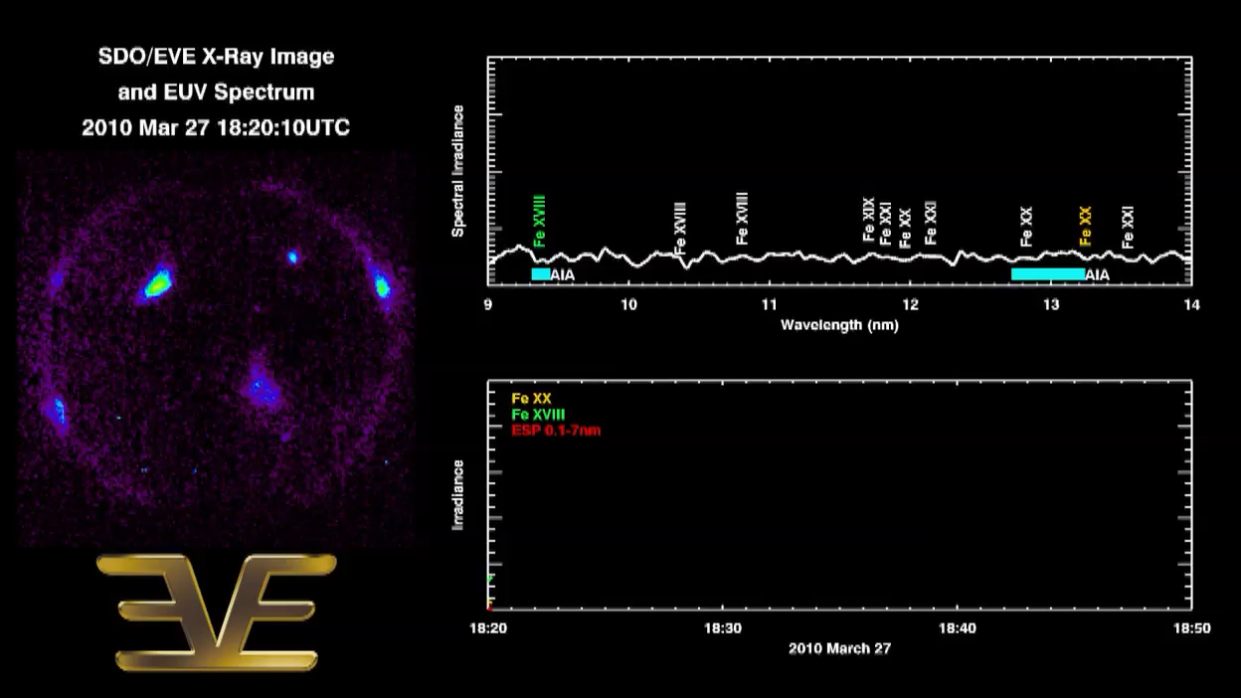
Solar Flares
They are massive localized enhancements in UV and x-ray emissions (~10²⁰ to 10²⁵ J
or ~10⁴ to 10⁹ 50 Megaton H-bombs
or combusting ~10¹²–10¹⁷ gallons of gas).
Notes:
4 x 10^14 BTUs = ~ 8 Billion 50,000 BTU furnaces
1 ton TNT = 4.184 GJ

Slide 23
Types of Collisionless Shock Waves
CIRs and/or SIRs

Slide 24
Energetic Particles (SEPs, ESPs, etc.)
solar energetic particles (SEPs) [e.g., Reames, 2017; Richardson et al., 2015]
gradual
likely due to ICME shocks
transport effects critical (e.g., diffusion during propagation)
long duration and broader spectra
smaller nonthermal abundance variations than impulsive
impulsive
shorter duration onset and decay than gradual
~1000 fold increase in ³He/⁴He abundance ratio
if interplanetary transient associated, then it is usually smaller, slower, and very narrow ICMEs
not (usually?) associated with γ-ray lines in low corona
never observe the elements Li, Be, or B
when ICME width ≥100º suprathermal H⁺ intensities increase by 10³
D.V. Reames “Solar Energetic Particles,” Lecture Notes Phys. 932, pp. 136, doi:10.1007/978-3-319-50871-9, 2017.
I.G. Richardson et al., “The Properties of Solar Energetic Particle Event-Associated Coronal Mass Ejections Reported in Different CME Catalogs,” Solar Phys. 290, pp. 1741-1759, doi:10.1007/s11207-015-0701-4, 2017.
Notes:
4 x 10^14 BTUs = ~ 8 Billion 50,000 BTU furnaces
1 ton TNT = 4.184 GJ

Slide 25
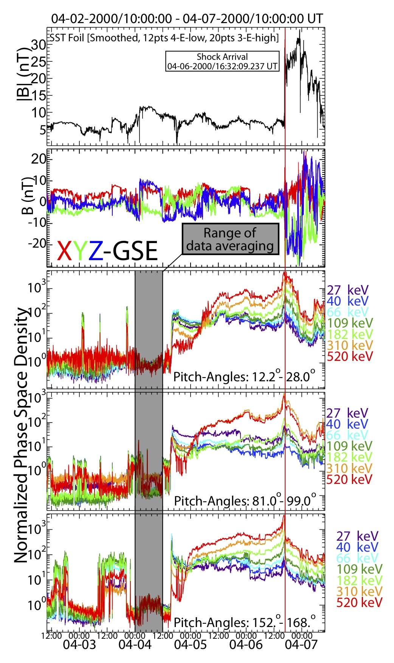
Particle Energization: Electrons
1 nT = 10 μG
Parallel
Perpendicular
Anti-parallel

Slide 26
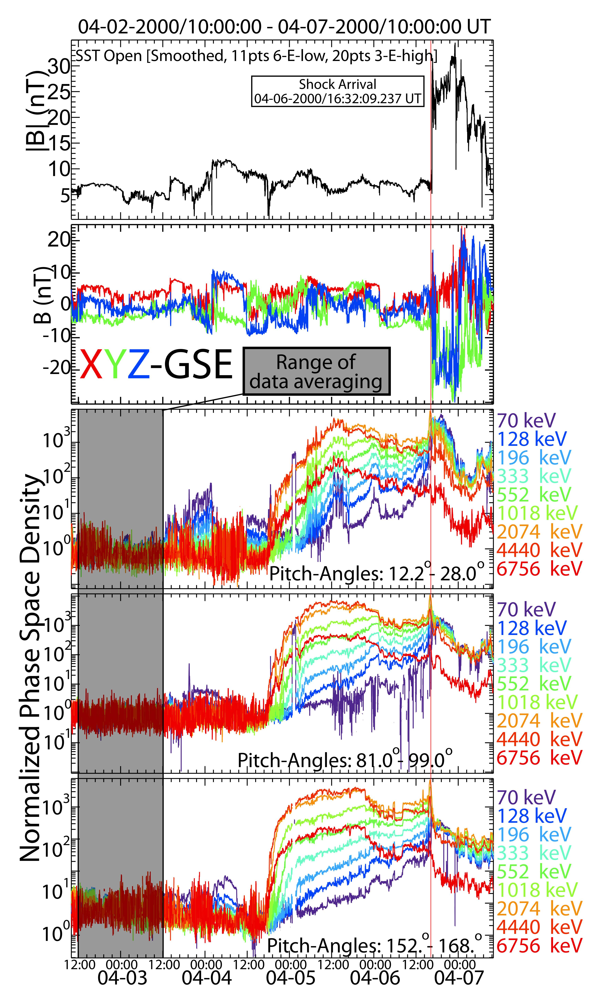
Particle Energization: Ions
1 nT = 10 μG
Parallel
Perpendicular
Anti-parallel

Slide 27
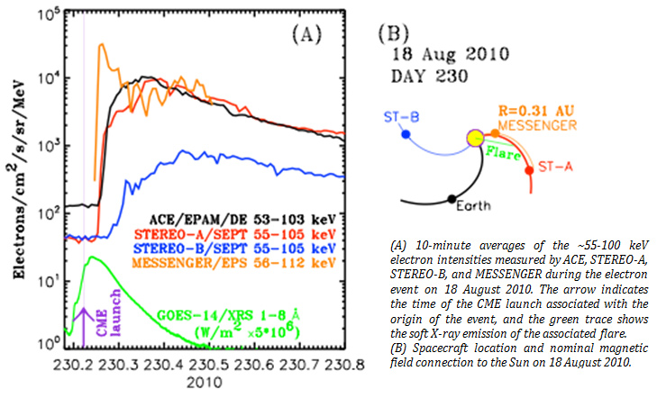
Puzzle: Longitudinal Dist. Ions
http://www.srl.caltech.edu/ACE/ACENews/ACENews139.html

Slide 28
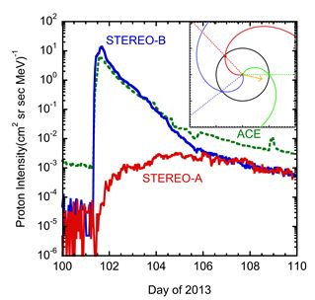
Puzzle: Longitudinal Dist. Ions
http://www.srl.caltech.edu/ACE/ACENews/ACENews170.html

Slide 29
Solar Wind Fluctuations
ICW = ion cyclotron wave [Jian et al., 2009; 2014; Wicks et al., 2016]
PCW = proton cyclotron wave
Sometimes called Alfvén/ion cyclotron waves
left-hand polarized, EM, mostly transverse with θ_{kB} ~ 0º
KAW = kinetic Alfven wave [e.g., Gershman et al., 2017; Krauss-Varban et al., 1994; Verscharen et al., 2019b]
both left- and right-hand polarized (depending on β and θ_{kB}), EM, wide range θ_{kB}
Magnetosonic-whistlers or fast modes or electromagnetic lower hybrid waves
right-hand polarized, EM, δB in phase with δn, typically θ_{kB} ~ 20º-60º [e.g., Coroniti et al., 1982; Verscharen et al., 2019a; Wilson III et al., 2013]
EM Turbulence [e.g., Verscharen et al., 2019b]
Lots more fluctuations at higher frequencies and smaller scales...
F.V. Coroniti, et al., “Whistler mode turbulence in the disturbed solar wind,” J. Geophys. Res. 87(A8), pp. 6029-6044, doi:10.1029/JA087iA08p06029, 1982.
D.J. Gershman, et al., “Wave-particle energy exchange directly observed in a kinetic Alfvén-branch wave,” Nature Comm. 8, pp. 10, doi:10.1038/ncomms14719, 2017.
L.K. Jian, et al., “Ion cyclotron waves in the solar wind observed by STEREO near 1 AU,” Astrophys. J. 709, pp. L105-L109, doi:10.1088/0004-637X/701/L105, 2009.
L.K. Jian, et al., “Electromagnetic waves near the proton cyclotron frequency: STEREO observations,” Astrophys. J. 786(123), pp. 18, doi:10.1088/0004-637X/786/2/123, 2014.
D. Krauss-Varban, et al., “Mode properties of low-frequency waves: Kinetic theory versus Hall-MHD,” J. Geophys. Res. 99(A4), pp. 5987-6009, doi:10.1029/93JA03202, 1994.
D. Verscharen, et al. “Self-induced scattering of strahl electrons in the solar wind,” Astrophys. J. 886(136), pp. 11, doi:10.3847/1538-4357/ab4c30, 2019a.
D. Verscharen, et al. “The multi-scale nature of the solar wind,” Living Rev. Sol. Phys. 16(5), pp. 136, doi:10.1007/s41116-019-0021-0, 2019b.
R.T. Wicks, et al., “A proton-cyclotron wave storm generated by unstable proton distribution functions in the solar wind,” Astrophys. J. 819(6), pp. 9, doi:10.3847/0004-637X/819/1/6, 2016.
L.B. Wilson III, et al., “Electromagnetic waves and electron anisotropies downstream of supercritical interplanetary shocks,” J. Geophys. Res. 118(1), pp. 5-16, doi:10.1029/2012JA018167, 2013.
Notes:
4 x 10^14 BTUs = ~ 8 Billion 50,000 BTU furnaces
1 ton TNT = 4.184 GJ

Slide 30
Summary
The solar wind is not in thermodynamic or even thermal equilibrium
The solar wind is commonly split into fast and slow
fast is hotter, larger temperature anisotropies, and more tenuous
slow is more collisional, but still collision rates are very small [typically ≤ 1 per day]
ICMEs vs CIRs/SIRs
ICMEs generate larger Dst but smaller relativistic electron enhancements and sometimes: ground induced currents, reformation of radiation belts, SEPs
CIRs/SIRs have weaker Dst but more severe relativistic electron enhancements, but do not cause a reformation of radiation belts or ground induced currents (inference on SEPs is less clear... at least to me)
Solar Energetic Particles: Gradual vs Impulsive
Gradual: almost all associated with ICME, long durations and broad spatial extent, and smaller abundance variations than impulsive
Impulsive: often blamed on solar flares but rarely if ever see g-ray emissions in low corona, no evidence of nuclear processes (i.e., don’t see Li, Be, B, or ²H or ³H), ~1000 fold increase in ³He/⁴He abundance ratio (³He not a nuclear reaction product), and sometimes associated with smaller, slower, and very narrow ICMEs
Notes:
4 x 10^14 BTUs = ~ 8 Billion 50,000 BTU furnaces
1 ton TNT = 4.184 GJ

Slide 31
Extras (no particular order)

Slide 32
Values vs Solar Min: X_{avg} ± X_{σ/N^(1/2)}
Parameter | 20/21 (~1976) | 21/22 (~1986) | 22/23 (~1996) | 23/24 (~’08-’09)
V_{sw} [km s⁻¹] | 449 ± 6 | 459 ± 7 | 422 ± 4 | 388 ± 4
B_{o} [nT] | 5.56 ± 0.12 | 5.78 ± 0.14 | 5.16 ± 0.08 | 4.02 ± 0.08
N_{p} [cm⁻³] | 8.2 ± 0.3 | 8.5 ± 0.3 | 8.0 ± 0.2 | 5.5 ± 0.2
T_{p,tot} [eV] | 10.8 ± 0.4 | 9.4 ± 0.4 | 7.2 ± 0.3 | 5.5 ± 0.2
β_{tot} [N/A] | 3.8 ± 0.2 | 3.4 ± 0.2 | 3.5 ± 0.1 | 4.1 ± 0.3
P_{dyn} [nPa] | 2.81 ± 0.07 | 2.97 ± 0.07 | 2.44 ± 0.04 | 1.40 ± 0.03
L.K. Jian et al., “Comparing Solar Minimum 23/24 with Historical Solar Wind Records at 1 AU,” Solar Phys. 274, pp. 321-344, doi:10.1007/s11207-011-9737-2, 2011.

Slide 33
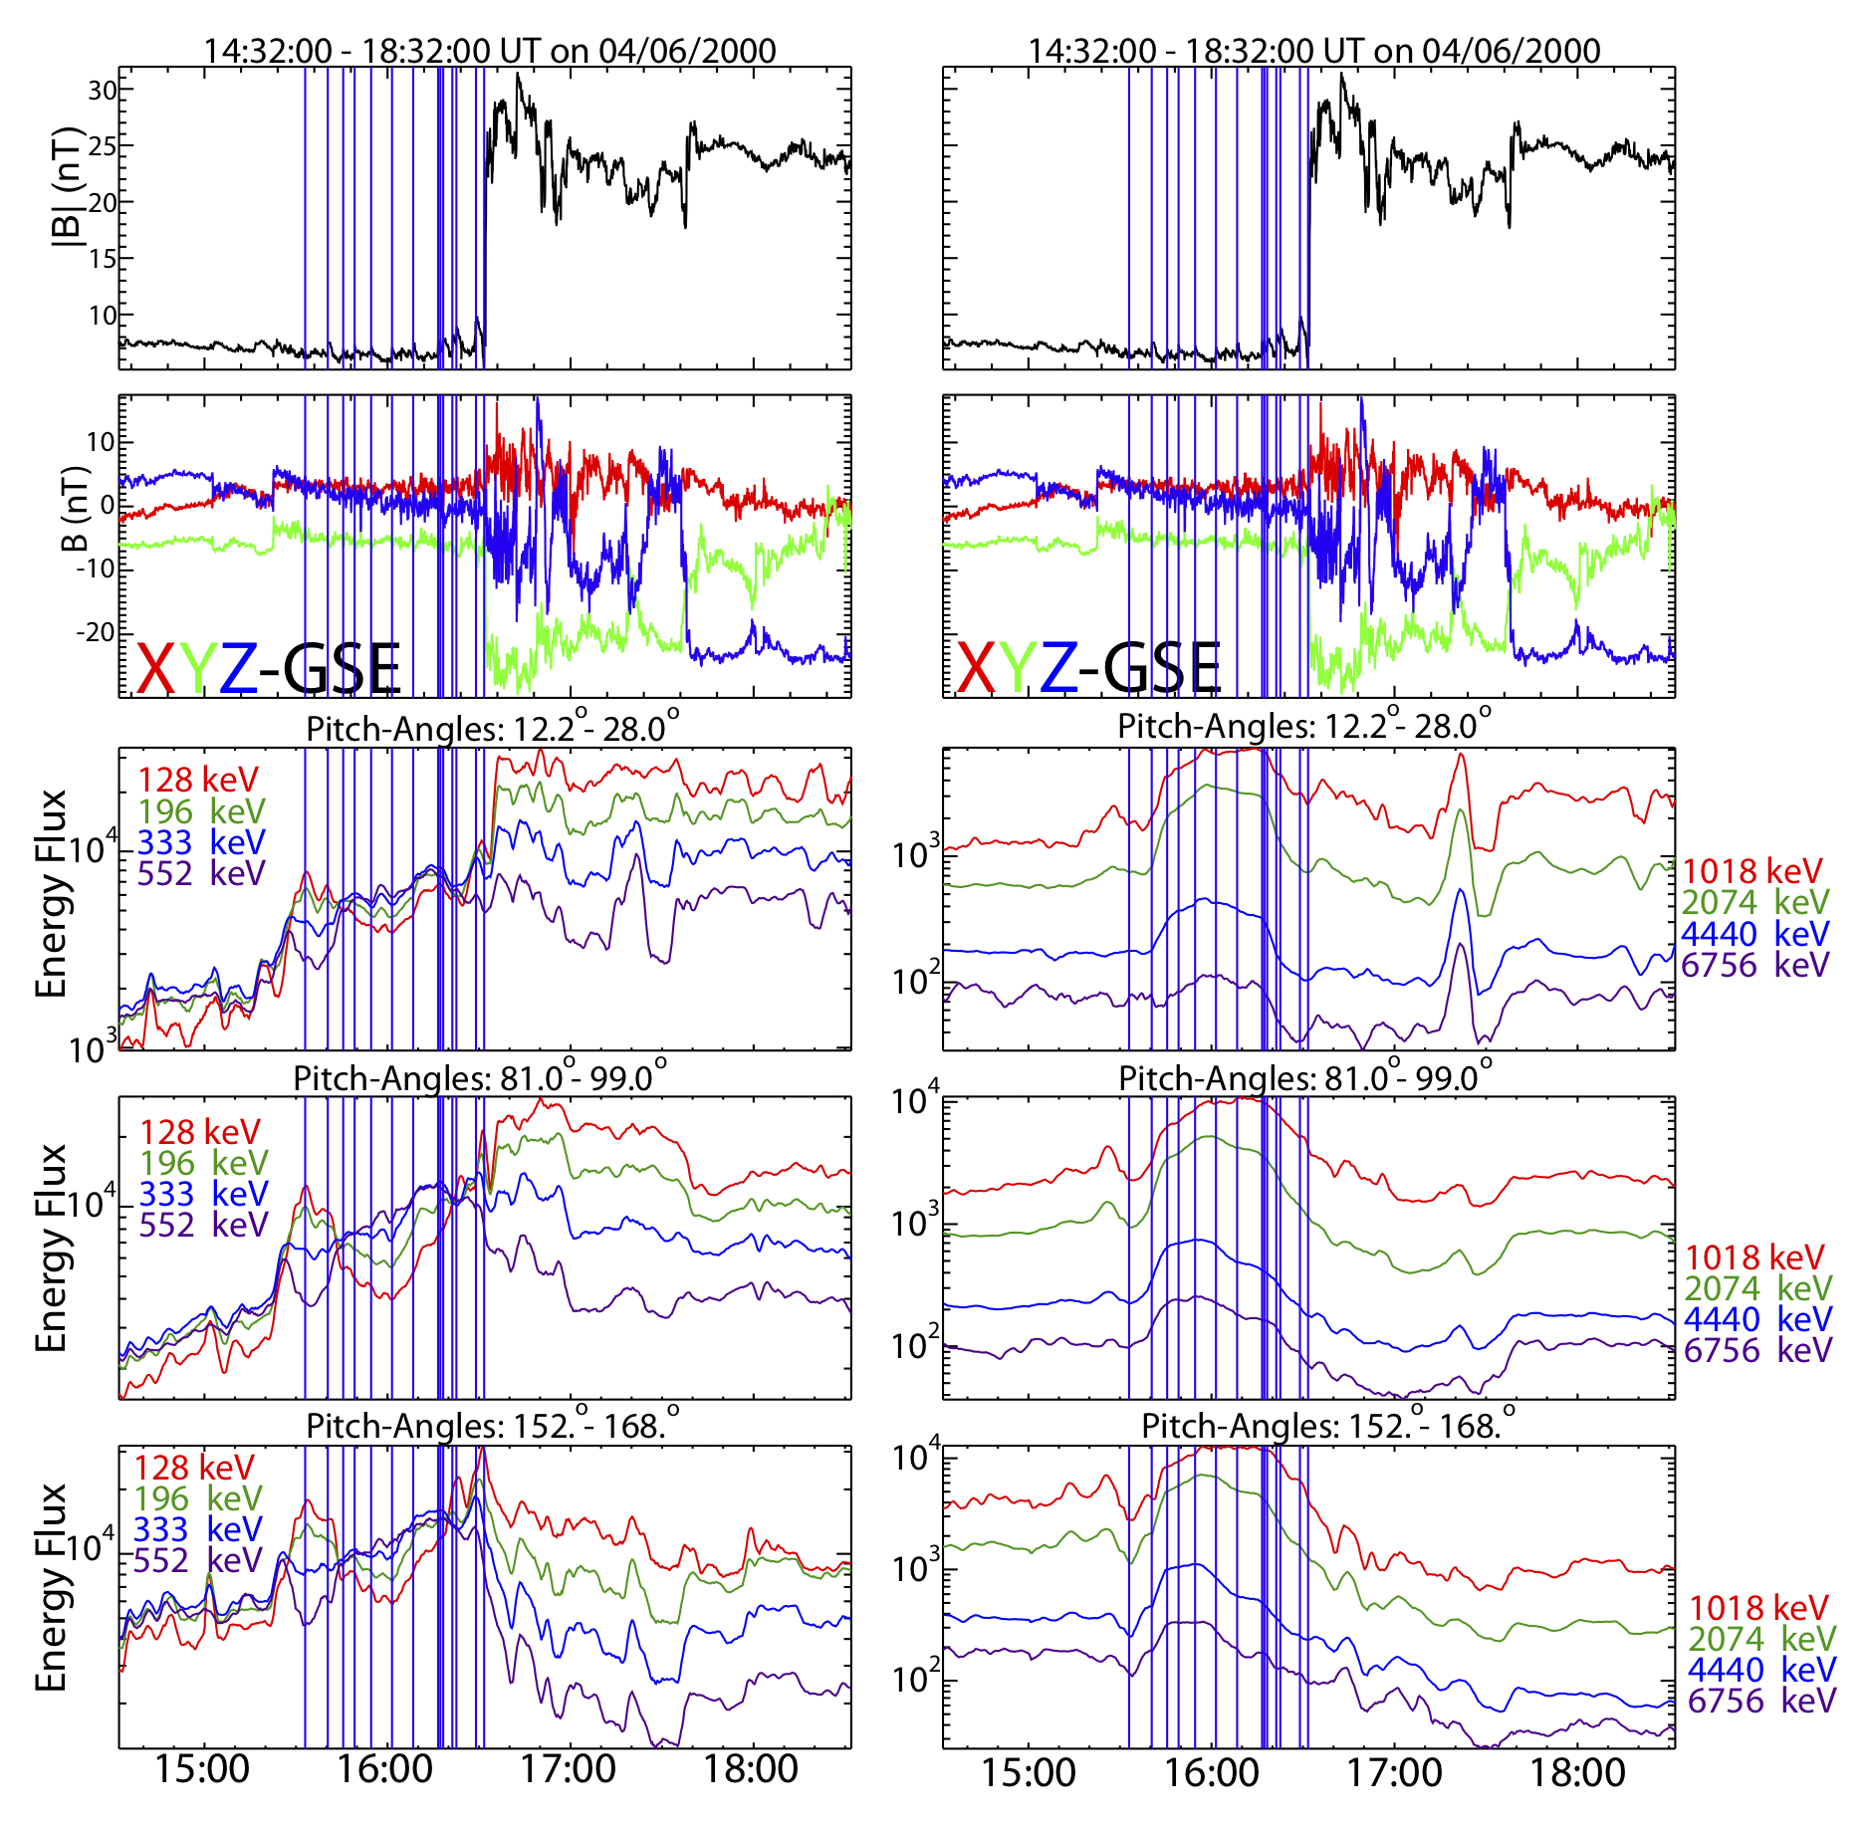
Particle Energization: Ions
1 nT = 10 μG
Parallel
Perpendicular
Anti-parallel

Slide 34
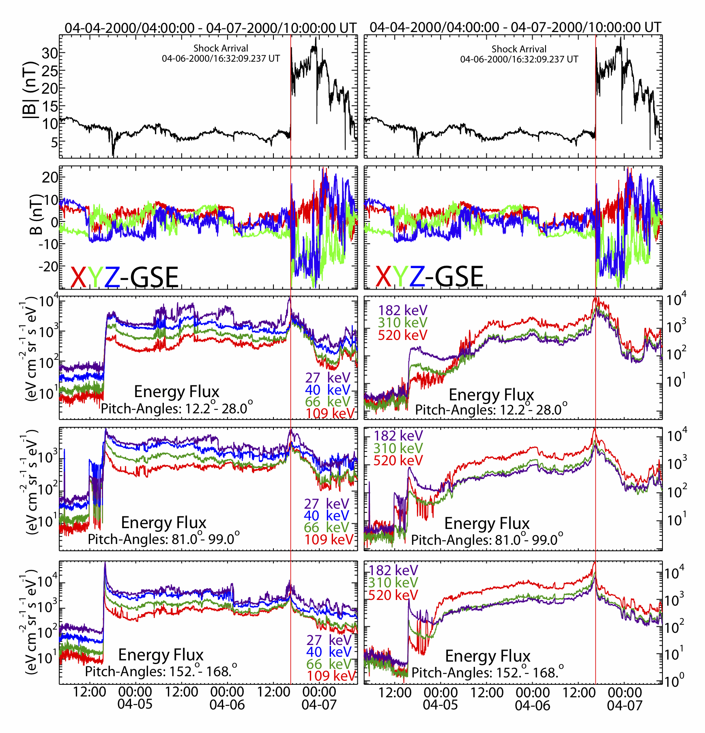
Particle Energization: Electrons
1 nT = 10 μG
Parallel
Perpendicular
Anti-parallel

Slide 35
SIRs at Solar Min: X_{avg} ± X_{σ/N^(1/2)}
Parameter | 22/23 (~1996) | 23/24 (~’08-’09)
V_{max} [km s⁻¹] | 554 ± 12 | 525 ± 15
V_{min} [km s⁻¹] | 349 ± 6 | 320 ± 5
V_{avg} [km s⁻¹] | 451 ± 8 | 423 ± 9
B_{max} [nT] | 12.8 ± 0.4 | 12.0 ± 0.6
P_{dyn,max} [nPa] | 7.2 ± 0.5 | 6.2 ± 0.6
# of SIRs | 42 | 41
# with shocks | 7 (17%) | 16 (39%)
L.K. Jian et al., “Comparing Solar Minimum 23/24 with Historical Solar Wind Records at 1 AU,” Solar Phys. 274, pp. 321-344, doi:10.1007/s11207-011-9737-2, 2011.

Slide 36
SIRs binned by year
L.K. Jian et al., “Comparing Solar Minimum 23/24 with Historical Solar Wind Records at 1 AU,” Solar Phys. 274, pp. 321-344, doi:10.1007/s11207-011-9737-2, 2011.

Slide 37
ICMEs at Solar Min: X_{avg} ± X_{σ/N^(1/2)}
Parameter | 22/23 (~1996) | 23/24 (~’08-’09)
V_{max} [km s⁻¹] | 388 ± 12 | 413 ± 14
V_{min} [km s⁻¹] | 331 ± 7 | 346 ± 9
V_{avg} [km s⁻¹] | 360 ± 6 | 379 ± 11
B_{max} [nT] | 13.0 ± 1.7 | 10.1 ± 1.4
P_{dyn,max} [nPa] | 7.2 ± 1.5 | 4.4 ± 1.0
# of SIRs | 4 | 8
# with shocks | 0% | 25%
L.K. Jian et al., “Comparing Solar Minimum 23/24 with Historical Solar Wind Records at 1 AU,” Solar Phys. 274, pp. 321-344, doi:10.1007/s11207-011-9737-2, 2011.

Slide 38
ICMEs binned by year
L.K. Jian et al., “Comparing Solar Minimum 23/24 with Historical Solar Wind Records at 1 AU,” Solar Phys. 274, pp. 321-344, doi:10.1007/s11207-011-9737-2, 2011.

Slide 39
Density Stats: Fast Solar Wind
Parameter | X_{min} | X_{max} | X_{mean} | X_{median} | X_{25%} | X_{75%}
N_{e} [cm⁻³] | 0.61 | 76.8 | 5.83 | 4.52 | 3.75 | 6.51
N_{p} [cm⁻³] | 0.53 | 69.9 | 5.07 | 4.04 | 3.19 | 5.70
N_{α} [cm⁻³] | 0.007 | 4.76 | 0.25 | 0.18 | 0.14 | 0.26
Density Stats: Slow Solar Wind
Parameter | X_{min} | X_{max} | X_{mean} | X_{median} | X_{25%} | X_{75%}
N_{e} [cm⁻³] | 0.34 | 104 | 11.0 | 9.28 | 6.37 | 13.8
N_{p} [cm⁻³] | 0.35 | 96.2 | 9.84 | 8.28 | 5.66 | 12.4
N_{α} [cm⁻³] | 0.005 | 7.91 | 0.27 | 0.21 | 0.13 | 0.33
*Note that uncertainties in particle density range from ~5% to 20%, depending on parameters and instrument limitations
It is also worth noting that the binning procedure and different cadences can affect these ratios.

Slide 40
Temperature Stats: Fast Solar Wind
Parameter | X_{min} | X_{max} | X_{mean} | X_{median} | X_{25%} | X_{75%}
T_{e,tot} [eV] | 3.16 | 53.9 | 12.2 | 11.8 | 10.3 | 13.6
T_{p,tot} [eV] | 0.68 | 375 | 27.7 | 24.4 | 17.8 | 33.2
T_{α,tot} [eV] | 0.98 | 965 | 67.2 | 55.6 | 19.4 | 92.8
Temperature Stats: Slow Solar Wind
Parameter | X_{min} | X_{max} | X_{mean} | X_{median} | X_{25%} | X_{75%}
T_{e,tot} [eV] | 2.43 | 52.7 | 11.3 | 11.0 | 9.26 | 13.0
T_{p,tot} [eV] | 0.53 | 200 | 9.46 | 7.54 | 4.47 | 12.4
T_{α,tot} [eV] | 0.65 | 370 | 22.9 | 11.5 | 5.31 | 31.6
*Note that uncertainties in particle density range from ~5% to 20%, depending on parameters and instrument limitations
It is also worth noting that the binning procedure and different cadences can affect these ratios.

Slide 41
Temperature Anisotropy: Fast Solar Wind
Parameter | X_{min} | X_{max} | X_{mean} | X_{median} | X_{25%} | X_{75%}
(T⊥/T//)_{e} | 0.71 | 2.65 | 1.25 | 1.22 | 1.11 | 1.35
(T⊥/T//)_{p} | 0.02 | 241 | 0.91 | 0.82 | 0.66 | 1.03
(T⊥/T//)_{α} | 0.01 | 71.1 | 1.25 | 0.95 | 0.66 | 1.46
Temperature Anisotropy : Slow Solar Wind
Parameter | X_{min} | X_{max} | X_{mean} | X_{median} | X_{25%} | X_{75%}
(T⊥/T//)_{e} | 0.66 | 2.35 | 1.06 | 1.04 | 1.00 | 1.10
(T⊥/T//)_{p} | 0.001 | 279 | 0.80 | 0.76 | 0.59 | 0.95
(T⊥/T//)_{α} | 0.004 | 401 | 0.96 | 0.84 | 0.59 | 1.13
*Note that uncertainties in particle density range from ~5% to 20%, depending on parameters and instrument limitations
It is also worth noting that the binning procedure and different cadences can affect these ratios.

Slide 42
Temperature Ratio Stats: Fast Solar Wind
Parameter | X_{min} | X_{max} | X_{mean} | X_{median} | X_{25%} | X_{75%}
(T_{e}/T_{p})_{tot} | 0.08 | 17.3 | 0.62 | 0.49 | 0.36 | 0.65
(T_{e}/T_{α})_{tot} | 0.02 | 9.51 | 0.46 | 0.19 | 0.12 | 0.45
(T_{α}/T_{p})_{tot} | 0.52 | 9.25 | 3.59 | 3.73 | 2.28 | 4.75
Temperature Ratio Stats: Slow Solar Wind
Parameter | X_{min} | X_{max} | X_{mean} | X_{median} | X_{25%} | X_{75%}
(T_{e}/T_{p})_{tot} | 0.10 | 25.3 | 1.79 | 1.42 | 0.92 | 2.29
(T_{e}/T_{α})_{tot} | 0.04 | 22.9 | 1.28 | 0.87 | 0.35 | 1.83
(T_{α}/T_{p})_{tot} | 0.34 | 18.4 | 2.52 | 1.95 | 1.38 | 3.52
*Note that uncertainties in particle density range from ~5% to 20%, depending on parameters and instrument limitations
It is also worth noting that the binning procedure and different cadences can affect these ratios.

Slide 43
Beta Stats: Fast Solar Wind
Parameter | X_{min} | X_{max} | X_{mean} | X_{median} | X_{25%} | X_{75%}
β_{e,tot} [N/A] | 0.02 | 681 | 1.05 | 0.73 | 0.51 | 1.08
β_{p,tot} [N/A] | 0.003 | 913 | 2.02 | 1.41 | 0.92 | 2.12
β_{α,tot} [N/A] | 0.0004 | 111 | 0.40 | 0.19 | 0.05 | 0.41
Beta Stats: Slow Solar Wind
Parameter | X_{min} | X_{max} | X_{mean} | X_{median} | X_{25%} | X_{75%}
β_{e,tot} [N/A] | 0.01 | 4330 | 3.37 | 1.62 | 0.95 | 2.89
β_{p,tot} [N/A] | 0.003 | 2530 | 1.97 | 1.13 | 0.64 | 1.86
β_{α,tot} [N/A] | 0.0002 | 112 | 0.17 | 0.06 | 0.02 | 0.18
*Note that uncertainties in particle density range from ~5% to 20%, depending on parameters and instrument limitations
It is also worth noting that the binning procedure and different cadences can affect these ratios.

Slide 44
Particle-particle Coulomb Collisions
Parameter | X_{min} | X_{max} | X_{mean} | X_{median} | X_{25%} | X_{75%}
ν_{ee} [# day⁻¹] | 0.01 | 23.5 | 1.01 | 0.70 | 0.43 | 1.30
ν_{pp} [# day⁻¹] | 0.00004 | 1.56 | 0.05 | 0.02 | 0.008 | 0.07
ν_{αα} [# day⁻¹] | 0.000006 | 0.47 | 0.009 | 0.003 | 0.001 | 0.01
ν_{ep} [# day⁻¹] | 0.005 | 10.4 | 0.45 | 0.31 | 0.19 | 0.58
ν_{eα} [# day⁻¹] | 0.0008 | 4.86 | 0.05 | 0.07 | 0.02 | 0.06
ν_{pα} [# day⁻¹] | 0.000003 | 0.11 | 0.002 | 0.001 | 0.0005 | 0.002
ν_{iaw} [# day⁻¹] | 5.72 | 232 | 4.39 | 4.16 | 3.30 | 52.2
Assuming δE ~ 0.1 mV/m

Slide 45
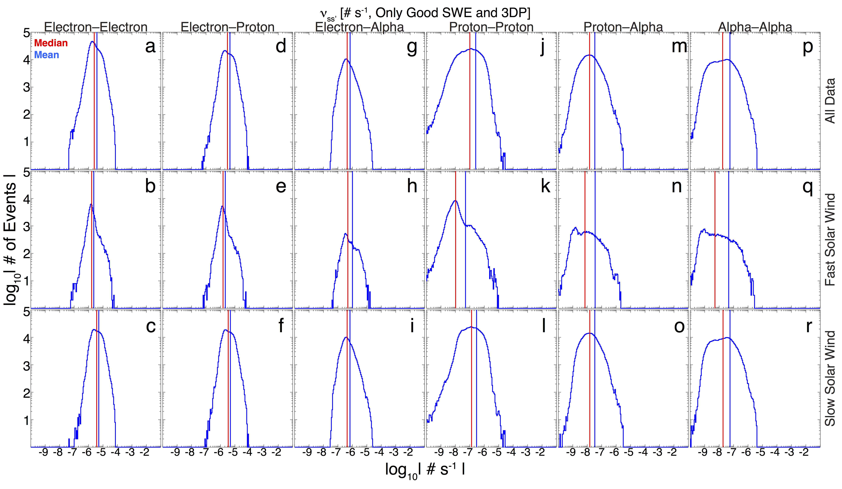

Slide 46
